Slide 1
Mobile Health Care Application Activity5 (Commercial and MVP-3)
Subject: ENSE 885as, "Topics in Computer-Supported Collaborative Work
Instructor Name: Timothy Macing
Presented by: Reema Jiyani

Slide 2
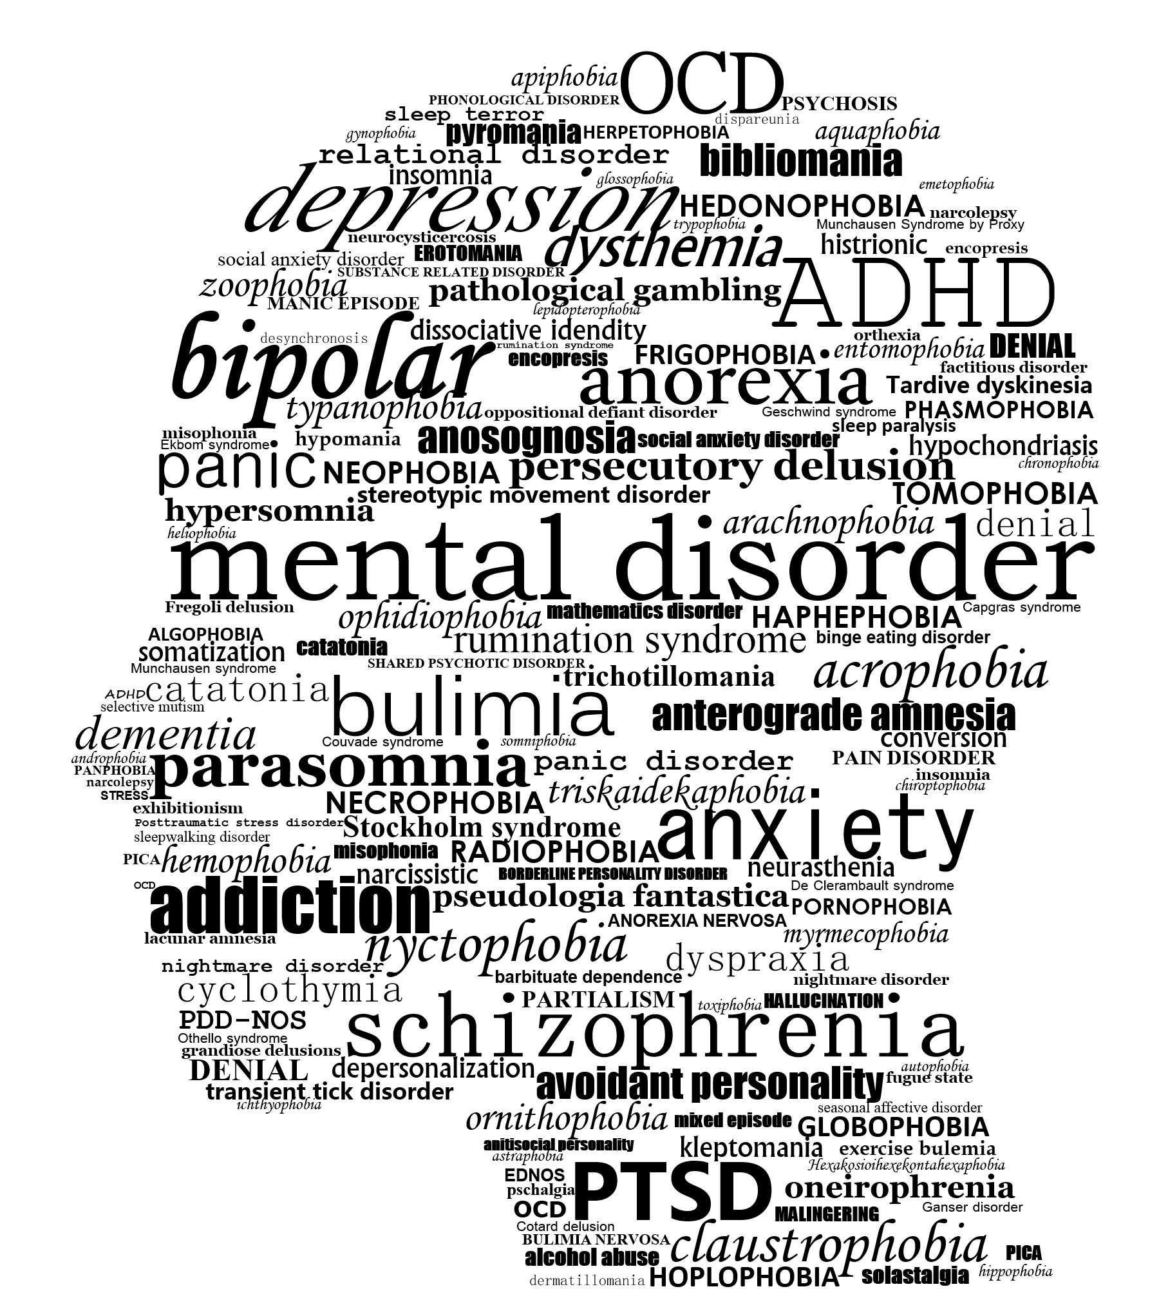
Outline
Commercial
Final MVP
Reflection

Slide 3
Final MVP & Demo
MVP3:
Forum Page (New Query, Resolved Query, Add Response)
Admin Side Application (Adding & Deleting (New Broadcast room, post, event), Dashboard)
Scrum Date: 8 June to 15 June (7 days)

Slide 4
Reflection
Consideration on project:
My experience is good with transforming prototype into real application and flutter make this experience easier in limited time.
Technology stack is easy and easily find lots of information about how beginner application is built.
MVPs evolution is little bit UI change to make user-friendly design.

Slide 5
Reflection
What went well?
Implementing flutter technology
Able to work on Agile framework and scrum
Able to finish Final MVP on time
by following professor advice to work on admin first. I am able to save time to work on forum which is good thing about this project

Slide 6
Reflection
What did not went well?
According to professor suggestion not able to perform sharing via email auto populate the subject
Because android is third party and it provide only image and description sharing. This facility is provide by google only.
Notification sharing is not fast because of firebase free version but it is working fine with android mobiles.

Slide 7
Reflection
Software design activities and findings:
From all the Activity 1 to 5:
Able to gather requirement for my project, Software design and architecture thorough flow chart and High Fidelity prototypes, Divide MVPs into scrum and able to perform project on time
Few concept used in my project:
Digital habitats, Global interaction, Dimensions of a Cop, Domain inside and outside, Practice & learning- (From/with, Formal/informal, inside/outside), Mis-information handling, features, platforms, configuration,etc.

Slide 8
Reflection
What I do the same on project:
Try to attract more health professional to this application.
What I do differently on project:
In future I am thinking to add AI based chat box to detect user condition and suggest them proper solution.

Slide 9
Thank you

